Slide 1
The Titles Search Run a Job Bulk Action
Batch updating records and sets from the Titles Search
Yoel Kortick
Senior Librarian

Slide 2
Agenda
Introduction
The Titles search Run a Job Bulk Action - Example One
The Titles search Run a Job Bulk Action - Example Two
Add Titles search results to an existing Itemized set
Add Titles search results to a new Itemized set
2

Slide 3
Introduction

Slide 4
Introduction
The “Titles Search Run a Job Bulk Action” allows the staff user in Alma to run a job on multiple records from the search results.
This is in addition to the existing functionality of first saving the records as a set and then running a job on the set..
This feature was added as part of an overall effort to streamline workflows in the new User Interface and add capabilities that will make work easier and more efficient.
Note that the ability to run jobs is according to users’ roles and privileges. This means that a staff user can run a job from the Titles Search results if he or she can also run it in the “Run a Job” page.

Slide 5
Introduction
The steps to run a job on multiple records from the search results are as follows:
Perform a “Titles” search (for example “All Titles”, “Physical Titles”, “Electronic Titles”, or “Digital Titles”)
Select all or specific records from the results
Click “Run a job” and from the sliding panel which opens select a job to run on the selected records from the search results.

Slide 6
Introduction
This is a significant time saver, because the alternative “Create and filter set” the “run a job” method involves several additional steps:
Perform a “Titles” search (for example “All Titles”, “Physical Titles”, “Electronic Titles”, or “Digital Titles”)
Click “Create and filter set”
Save the set
Access “Run a job” at “Admin > Manage Jobs and Sets > Run a Job”
  This means, unlike the sliding panel on the “Title search run a job bulk action”, we have left the screen where we were and “lost the context”
Choose desired Job
Choose desired Set
If needed go back to the “Titles” search from where we started

Slide 7
Introduction
Note that the “Titles Search Run a Job Bulk Action” is in no way intended to replace the “Create and filter set” method whereby first a set is saved.
There is a place (“use case”) for the “Titles Search Run a Job Bulk Action” method and there is a place (“use case”) for the “Create and filter set” method.
For example, the “Titles Search Run a Job Bulk Action” would be most useful if there is no intention to later perform additional actions in the same set.
The “Titles Search Run a Job Bulk Action” is a “one time” update on the records. If it is desired to again later update the same records, then an additional search would need to first be made.

Slide 8
Introduction
Additionally, it is also possible from the Title Search results to add all or specific results to an existing Itemized set as follows:
Perform a “Titles” search (for example “All Titles”, “Physical Titles”, “Electronic Titles”, or “Digital Titles”)
Select all or specific records from the results
Click “Add to Itemized Set” and select the desired existing set

Slide 9
Introduction
This saves time, as the user does not need to
  First go to the list of sets at “Admin > Manage Jobs and Sets > Manage Sets”
  Filter by itemized sets and select one
  Choose “Add Members to Set”
  Perform a search to find the records to add as members
  Select the desired records and choose “Add Selected”
  Click “Done”

Slide 10
Introduction
Further, it is also possible from the Title Search results to add all or specific results to a new Itemized set as follows:
Perform a “Titles” search (for example “All Titles”, “Physical Titles”, “Electronic Titles”, or “Digital Titles”)
Select all or specific records from the results
Click “Create Itemized Set” and add the records to a new set

Slide 11
Introduction
This saves time, as the user does not need to
  First go to the list of sets at “Admin > Manage Jobs and Sets > Manage Sets”
  Click “Create Itemized Set” and fill in the Itemized Set Details
  Perform a search to find the records to add as members
  Select the desired records
  Choose “Add Selected”
  Click “Done”

Slide 12
The Titles search Run a Job Bulk Action - Example One

Slide 13
The Titles search Run a Job Bulk Action - Example One
In this example we want to run an existing normalization process called “YLK - Add 651 Taiwan History if not exists” on certain titles which have keyword “Taiwan” and are resource type “Book – Physical”.
This normalization process will add a 651_0 field with subfield a “Taiwan” and subfield x “History” if there is not already such a field.
Our focus here is not on the syntax of the normalization rule, or even on the validity of adding such a field.
Our focus here is on how we can quickly and easily run a normalization process on search results.

Slide 14
The Titles search Run a Job Bulk Action - Example One
The steps will be:
Perform an “All Titles” search for keywords = Taiwan and facet by resource type “Book – Physical”.
Select specific records from the results
Click “Run a job” and from the sliding panel which opens select a job to run on the selected records from the search results.
Select the job
Submit the job

Slide 15
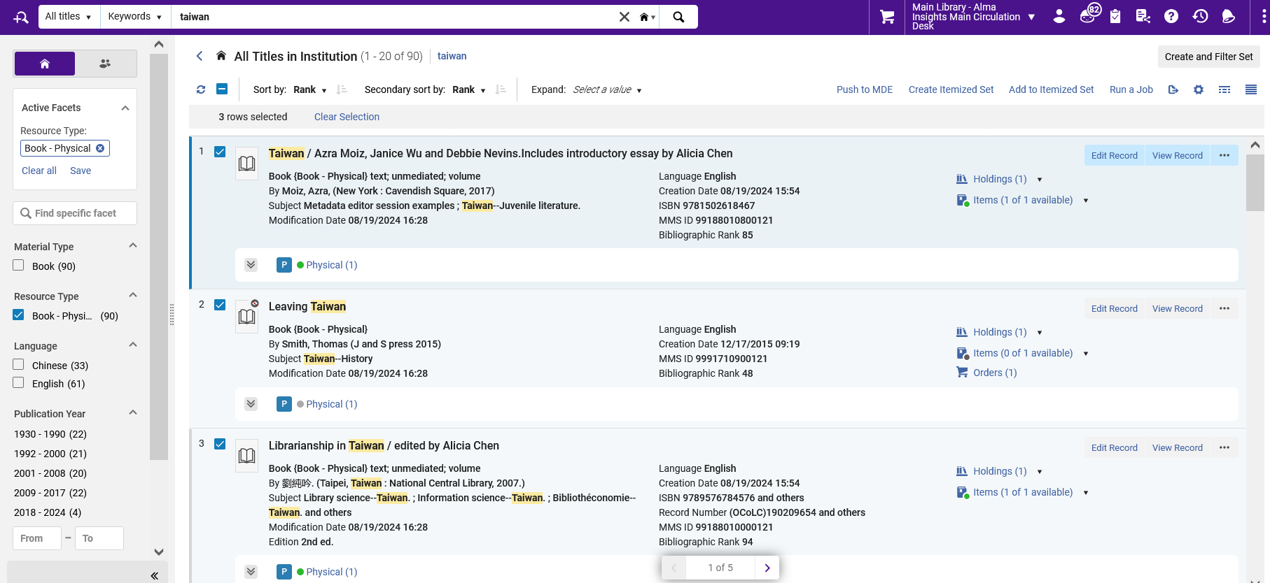
The Titles search Run a Job Bulk Action - Example One
Here are steps 1, 2 and 3 (search, facet, run a job)

Slide 16
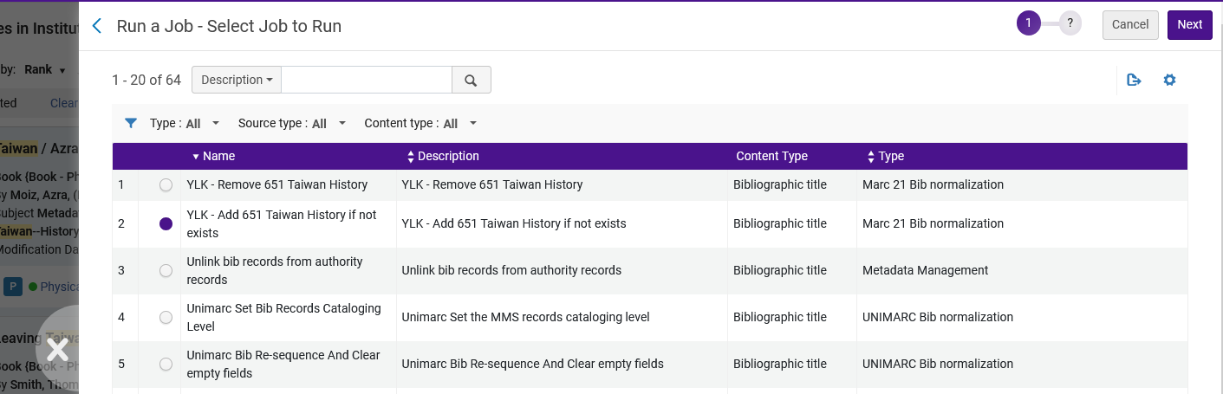
The Titles search Run a Job Bulk Action - Example One
Here is step 4 (select job)
Note that this opened in a sliding panel so that when it closes the user will be where he or she was before running the job and not “lose context”

Slide 17
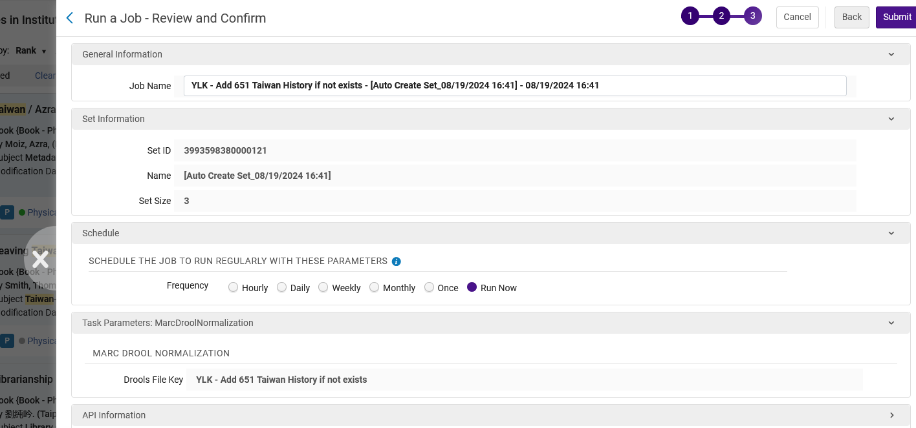
The Titles search Run a Job Bulk Action - Example One
Here is step 5 (submit)

Slide 18
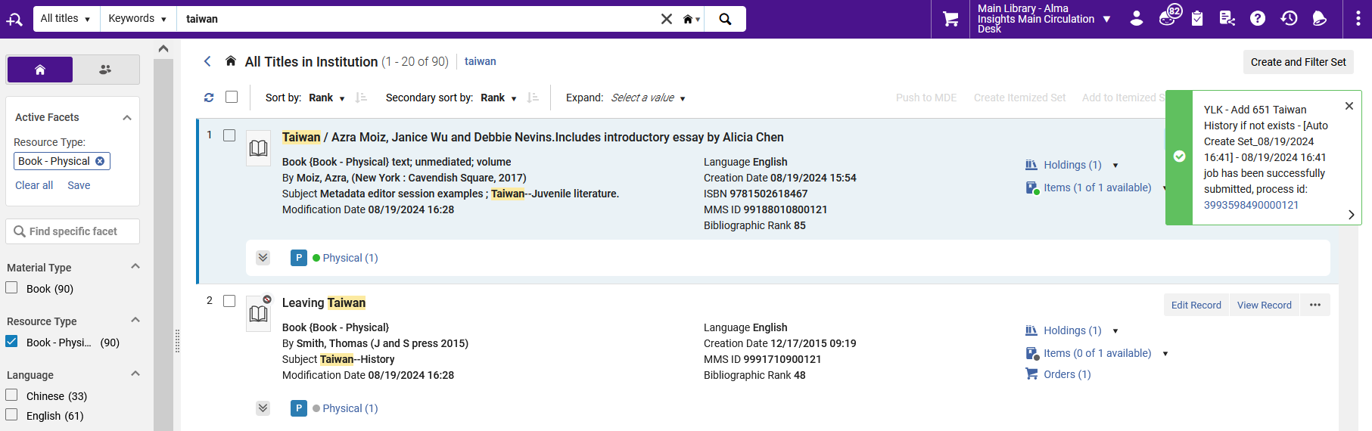
The Titles search Run a Job Bulk Action - Example One
The job gets sent

Slide 19
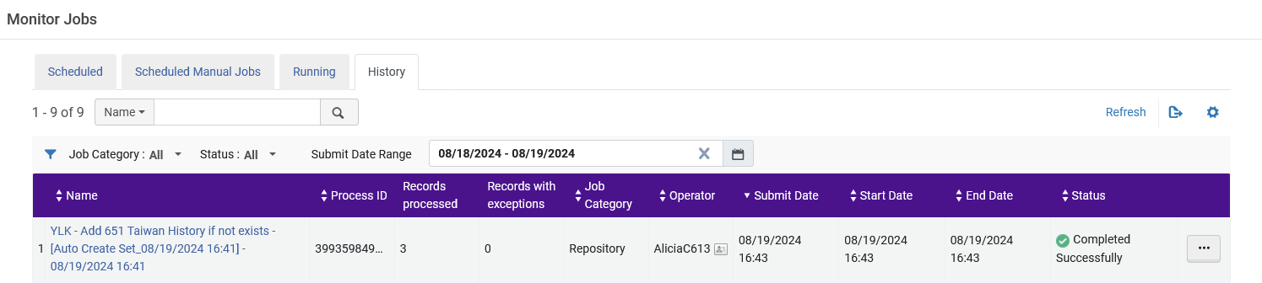
The Titles search Run a Job Bulk Action - Example One
The job completes

Slide 20
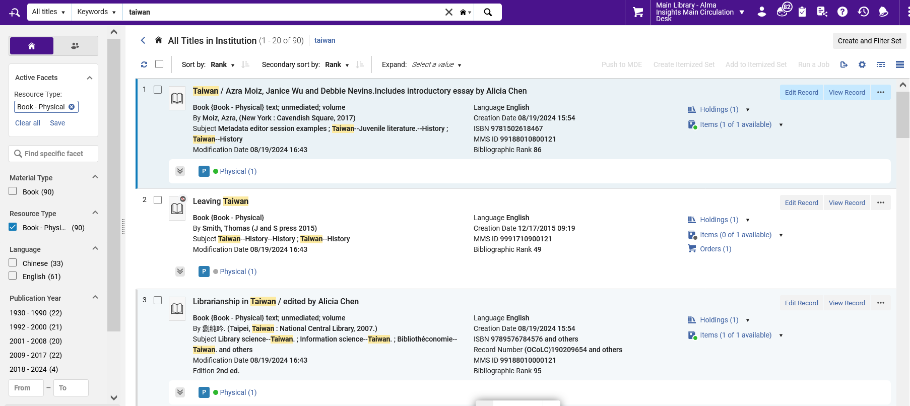
The Titles search Run a Job Bulk Action - Example One
The records we selected got modified

Slide 21
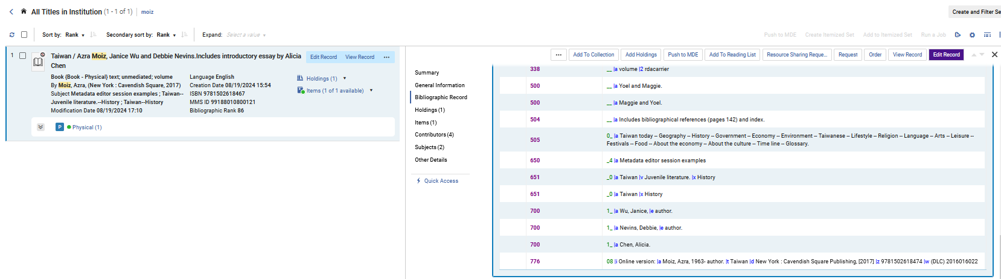
The Titles search Run a Job Bulk Action - Example One
The job updated the records. Here is one example in side by side view.

Slide 22
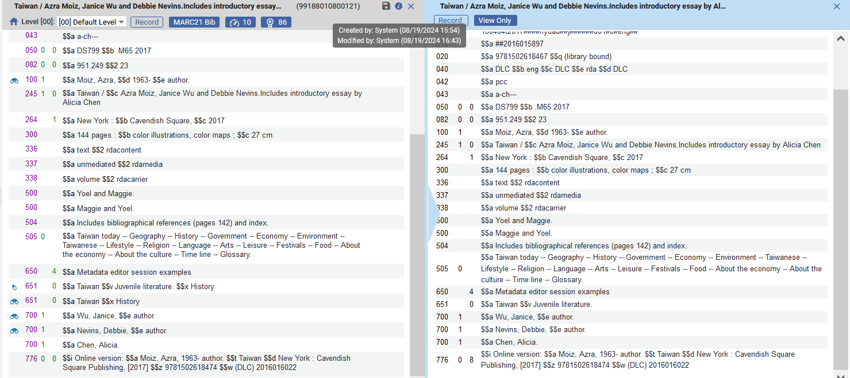
The Titles search Run a Job Bulk Action - Example One
The job updated the records. Here is one example in the Metadata Editor.
The record was updated by “System” (the job)
This is one record (as an example) in “View Versions” of the Metadata Editor
This field was added from the Normalization Process job

Slide 23
The Titles search Run a Job Bulk Action - Example Two

Slide 24
The Titles search Run a Job Bulk Action - Example Two
In this example we want to run the job “Suppress MMS from Discovery” on certain titles which have keyword “Taiwan” and are resource type “Book – Physical”.

Slide 25
The Titles search Run a Job Bulk Action - Example Two
The steps will be:
Perform a “Physical Titles” search for keywords = Taiwan and facet by resource type “Book – Physical”.
Select specific records from the results
Click “Run a job” and from the sliding panel which opens select a job to run on the selected records from the search results.
Select the job
Submit the job

Slide 26
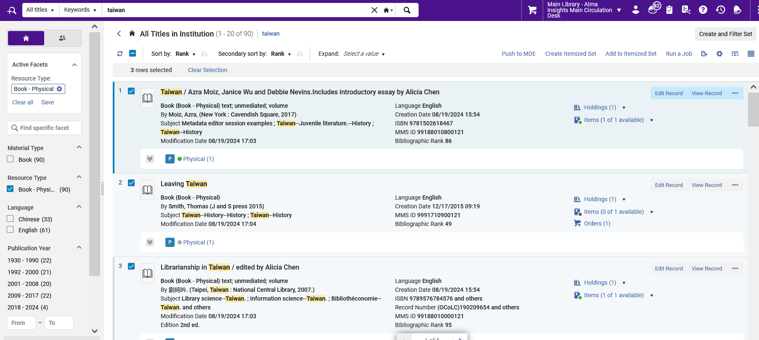
The Titles search Run a Job Bulk Action - Example Two
Here is steps 1, 2 and 3 (search, facet, run a job)
Note that currently no records are suppressed

Slide 27
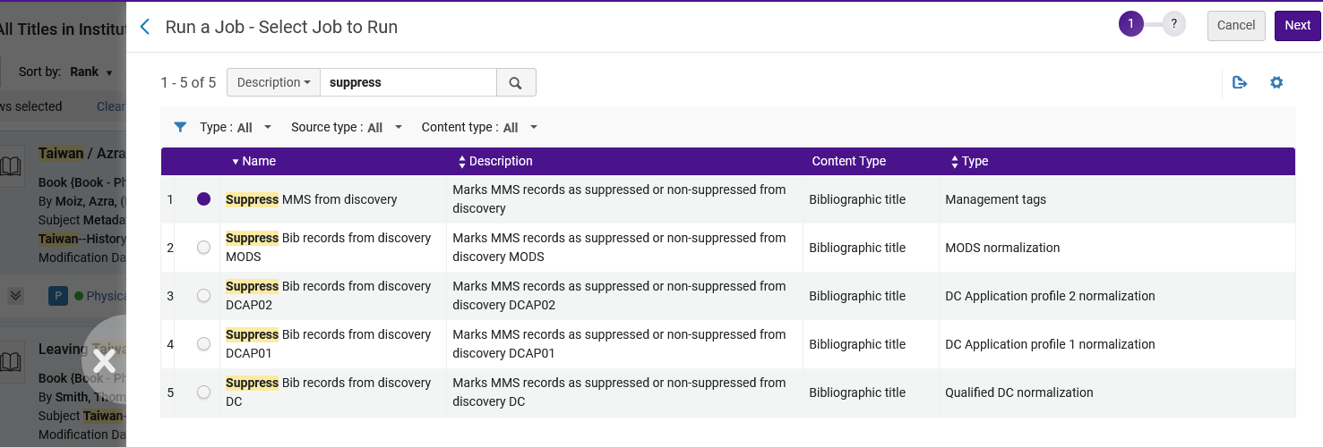
The Titles search Run a Job Bulk Action - Example Two
Here is step 4 (select job)
Note that this opened in a sliding panel so that when it closes the user will be where he or she was before running the job and not “lose context”

Slide 28
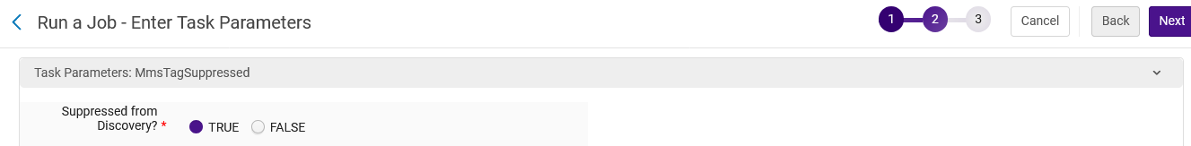
The Titles search Run a Job Bulk Action - Example Two
Fill in parameters as desired

Slide 29
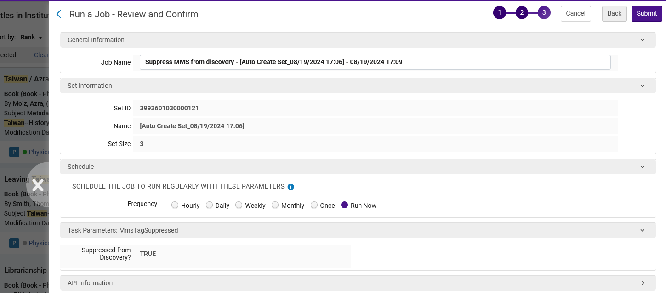
The Titles search Run a Job Bulk Action - Example Two
Here is step 5 (submit)

Slide 30
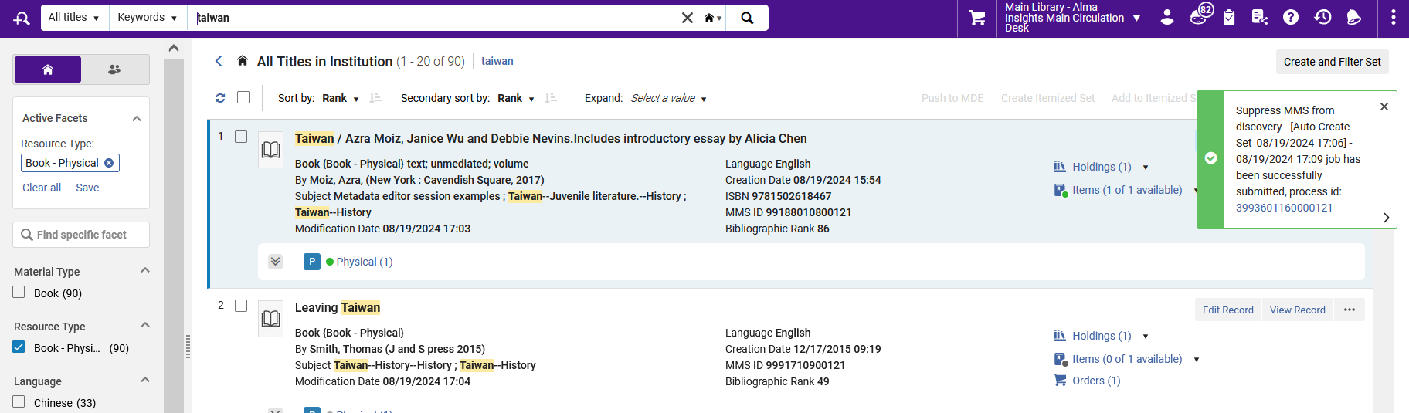
The Titles search Run a Job Bulk Action - Example Two
The job gets sent

Slide 31
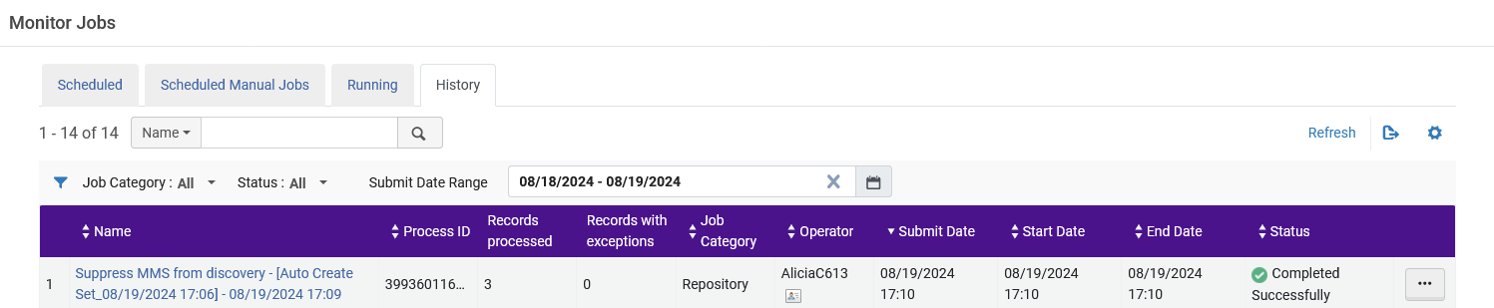
The Titles search Run a Job Bulk Action - Example Two
The job completes

Slide 32
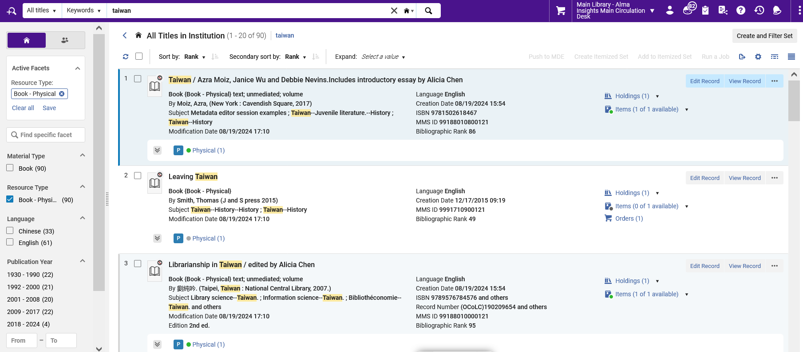
The Titles search Run a Job Bulk Action - Example Two
The records we selected got modified
The records are now suppressed from the job “Suppress MMS from Discovery”

Slide 33
Add Titles search results to an existing Itemized set

Slide 34
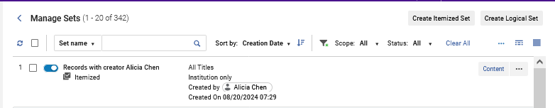
Add Titles search results to an existing Itemized set
In this example we already have an itemized set of type “All Titles” called “Records with creator Alicia Chen”

Slide 35
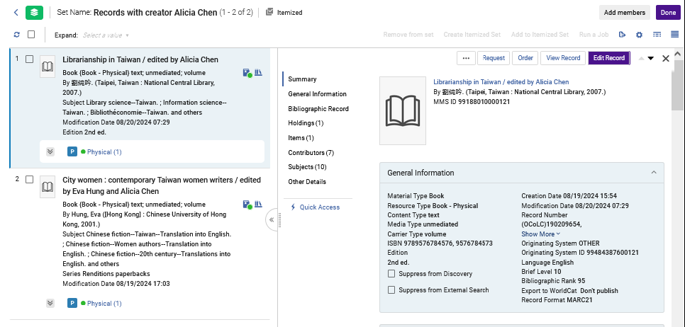
Add Titles search results to an existing Itemized set
The set has two records

Slide 36
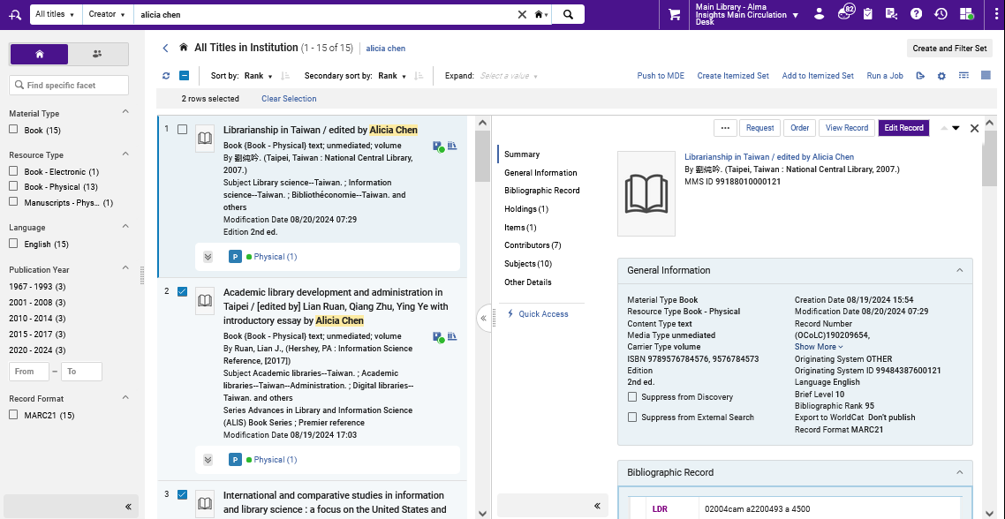
Add Titles search results to an existing Itemized set
From an All Titles search we select two other records and click “Add to Itemized Set”
We will add these records to an existing Itemized set

Slide 37
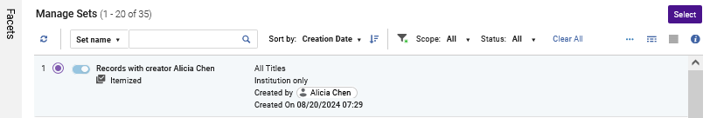
Add Titles search results to an existing Itemized set
We choose the desired set and click “Select”
Note that because we are coming from an “All Titles” search all of the sets from which we can choose are pre filtered by type “All titles”

Slide 38
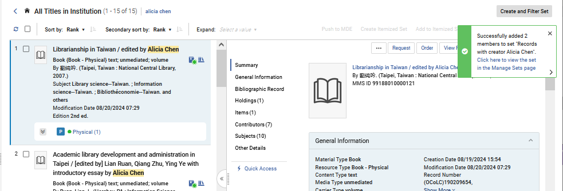
Add Titles search results to an existing Itemized set
We receive a confirmation message that the two records have successfully been added to the existing Itemized set “Records with creator Alicia Chen”.

Slide 39
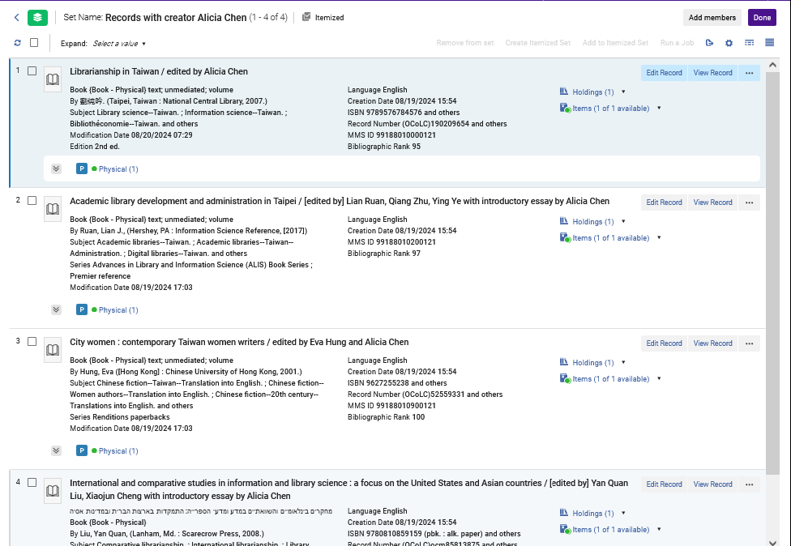
Add Titles search results to an existing Itemized set
The set now has four records (instead of only two which we originally had)
These are the two records which we added to the set by selecting from an All Titles search and clicking “Add to Itemized Set”

Slide 40
Add Titles search results to a new Itemized set

Slide 41
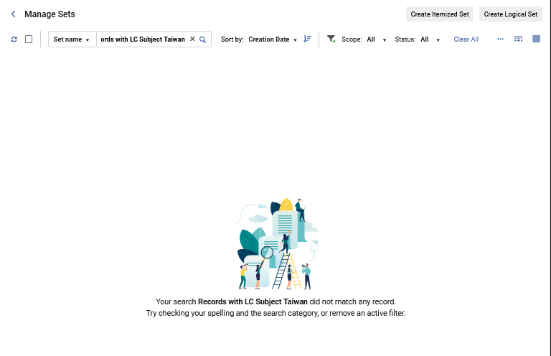
Add Titles search results to a new Itemized set
In this example we do not already have an itemized set of type “All Titles” called “Records with LC Subject Taiwan”

Slide 42
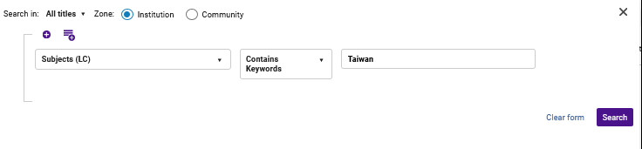
Add Titles search results to a new Itemized set
We perform an All Titles search for records with LC Subject Taiwan

Slide 43
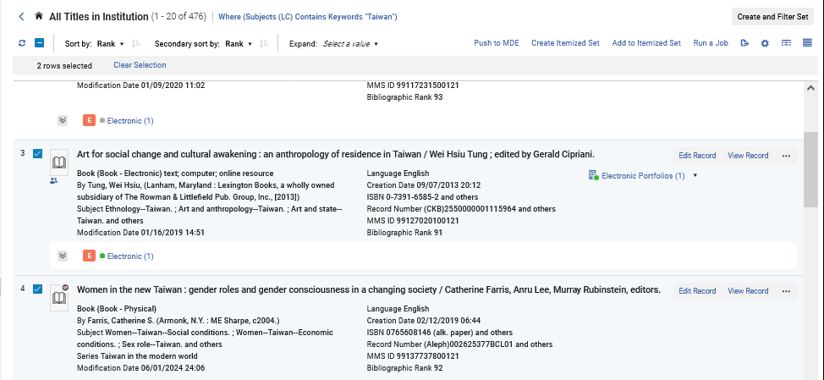
Add Titles search results to a new Itemized set
From the search results we select the desired records and click “Create Itemized Set”

Slide 44
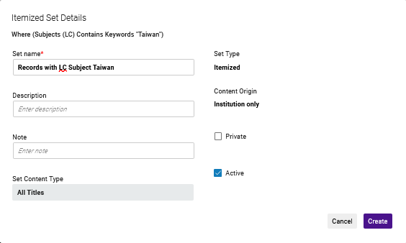
Add Titles search results to a new Itemized set
We fill in the Itemized Set Details and we will call the set “Records with LC Subject Taiwan”

Slide 45
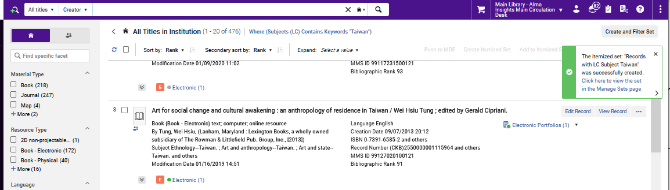
Add Titles search results to a new Itemized set
We receive confirmation that the set has been created

Slide 46
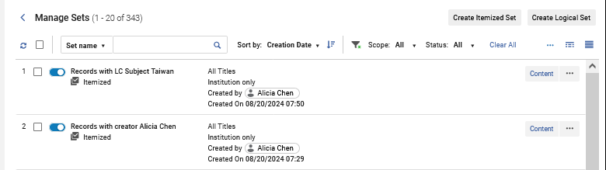
Add Titles search results to a new Itemized set
Here is the new set

Slide 47
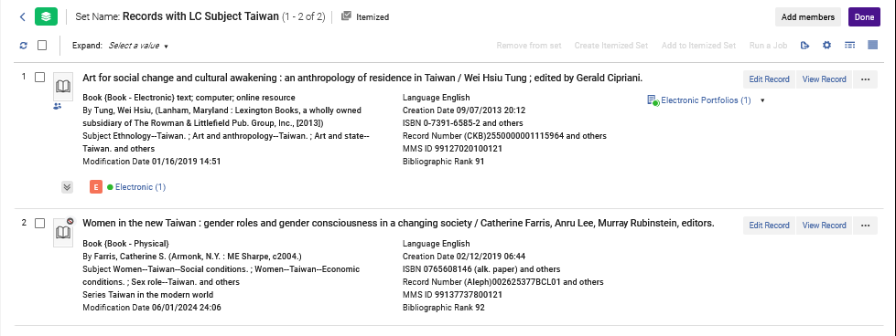
Add Titles search results to a new Itemized set
The new set has the two records which we added to it

Slide 48
Thank You

